Slide 1
Data Analysis
Emanuele Della Valle
Prof. @ Politecnico di Milano & Partner @ Quantia Consulting
Marco Balduini
Founder & CEO @ Quantia Consulting

Slide 2
Introduction

Slide 3
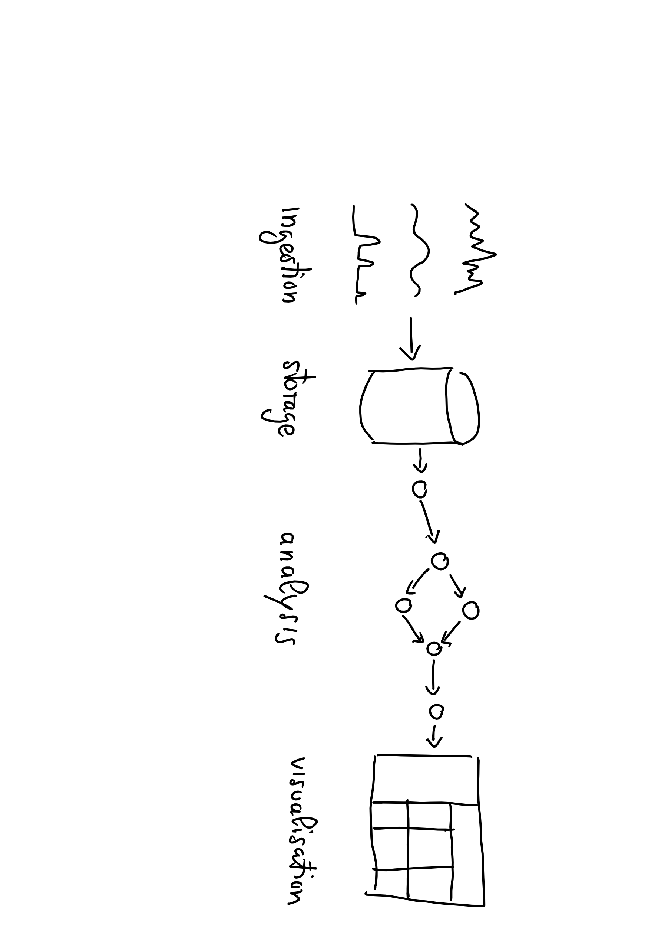
Data Lifecycle

Slide 4

Data Lifecycle

Slide 5
Flux

Slide 6
What Is Flux?
Flux is a functional data scripting and query language
Written to be:
Useable: easy to learn
Readable: developers read more code than we write
Composable: developers can build onto the language
Testable: queries are code
Contributable: open source contributions matter
Shareable: developers read more code than we write

Slide 7
What is Flux? (cont.)
Open Source (MIT)
Data-first mentality
Streaming Data
Planner-optimized
Compatible with multiple sources and sinks

Slide 8
Flux vs. InfluxQL
Flux is an alternative to InfluxQL with additional functionality like:
Joins
Math across measurements
Sort by any column
Pivot
Histograms
Covariance
Reference: https://v2.docs.influxdata.com/v2.0/query-data/

Slide 9
Basic Flux Language Elements
Every Flux query needs:
data source
time range
data filters
Anonymous function
from(bucket:"telegraf/autogen")
|> range(start:-1h)
|> filter(fn: (r) =>
r._measurement == "cpu" and
r._field == "system" and
r._value > 2000.0)
Pipe-forward operator: chain operations together

Slide 10
Flux Data Model
:o
An infinite stream…
of finite tables…
identified by the GroupKey

Slide 11
From bucket to tables
_time | host | _field | _value
1492…0 | serverA | system | 2342.2
1492… | serverA | system | 477.4
GroupKey[host=serverA,_field=system]
_time | host | _field | _value
1492…1 | serverB | system | 2.779
1492… | serverB | system | 1274.5
GroupKey[host=serverB,_field=system]
_time | host | _field | _value
1492…1 | serverB | idle | 1789.4
1492… | serverB | idle | 2475.9
GroupKey[host=serverB,_field=idle]
[…]
from(bucket:"telegraf/autogen")
|> range(start:-1s)
_time
host
idle
system
1492…0
serverA
1.667
2342.2
…
…
…
…
1492…1
serverB
1789.4
2.779

Slide 12
Query Process
:o
For Each Table:
Convert incoming rows into 0 or more outgoing rows
Map outgoing rows to tables

Slide 13
_time | host | _field | _value
1492…0 | serverA | system | 2342.2
1492… | serverA | system | 477.4
GroupKey[host=serverA,_field=system]
|> filter(fn: (r) =>
r._measurement == "cpu" and
r._field == "system" and
r._value > 2000.0)
_time | host | _field | _value
1492…1 | serverB | system | 2.779
1492… | serverB | system | 1274.5
GroupKey[host=serverB,_field=system]
_time | host | _field | _value
1492…0 | serverA | system | 2342.2
GroupKey[host=serverA,_field=system]
_time | host | _field | _value
1492…1 | serverB | system | 2.779
GroupKey[host=serverB,_field=system]
[…]
_time | host | _field | _value
1492…1 | serverB | idle | 1789.4
1492… | serverB | idle | 2475.9
GroupKey[host=serverB,_field=idle]

Slide 14
The Life of a Flux Query
Client
Server
query text
Parser
AST
Evaluator
Query Op-Spec
Procedure Spec
Planner/ Optimizer
Transformation Spec
:)

Slide 15
Wrap up of Key terms and terminology
Bucket: Named data source with retention policy
Pipe-forward operator |> : chain operations (e.g., time range and data filters) together
Table: data is returned in annotated CSVs, represented as tables
Group Key: list of columns for which every row in the table has the same value

Slide 16
Exploring Flux Basics

Slide 17

Key concepts
window
Data Sources
Registered Continuous Query
streams of answer
input streams
E. Della Valle

Slide 18
Windows
Streams are infinite in nature
Processing can end only if the input is finite
A window operator selects a finite portion of a stream
Time range is a window operator whose input is a time interval specified either stating an absolute start and end time
range(start: 2019-10-01T00:00:00Z, stop: 2019-10-01T00:05:00Z)
or stating a relative time period relative
range(start:-2h, stop: -1h)
range(start:-1h)

Slide 19

Let’s get dirty!
3

Slide 20
Continuous Linear Pizza Oven
Learning goals:
Data source
Window
Tables
s2
s1

Slide 21
Task
Extract all the measurements in a given range
Absolute: from 2019-10-01T00:00:00Z to 2019-10-01T00:10:00Z
Relative: in the last 24 hours
Take home message
The range() function extracts from the named bucket all the possible tables in the given time range

Slide 22
Let’s get dirty!
4

Slide 23
Continuous Linear Pizza Oven
Learning goals:
Filter by tag
s2
s1

Slide 24
Task
Extract the temperature data from the cooking base area (sensor S1)
Take home message
The filter() function applied to tags selects only the table(s) of your interest from all the possible tables

Slide 25
Let’s get dirty!
5

Slide 26
Continuous Linear Pizza Oven
Learning goals:
Filter by value
s2
s1

Slide 27
Task
Extract the measurements from the cooking base area (sensor S1) with a temperature under 300°
Take home message
The filter() function applied to values selects only the row(s) of your interest from all the possible tables

Slide 28
Let’s get dirty!
6

Slide 29
Continuous Linear Pizza Oven
Learning goals:
Function
Aggregates
Selectors
s2
s1

Slide 30
Task
Aggregator - Extract the average temperature in the cooking base area
Selector - Extract the last humidity measurements from the cooking base area
Take home message
Aggregators (e.g. mean) compress each table in a row
Selectors (e.g. last) select specific row(s) from each table

Slide 31
Exploring Flux Windowing

Slide 32
Recall
window
Data Sources
Registered Continuous Query
streams of answer
input streams
E. Della Valle

Slide 33
Windows
Streams are infinite in nature
Processing can end only if the input is finite
A window operator selects a finite portion of a stream
We have seen the time range operator
Flux includes a set of window operators that tumble across the results of the time range operator
e.g. aggregateWindow(every: 60m, fn: mean)

Slide 34

Tumble?

Slide 35
Tumbling windows
E. Della Valle
[1]

Slide 36
Tumbling windows
E. Della Valle
[1] [2]

Slide 37
Tumbling windows
E. Della Valle
[1] [2] [3]

Slide 38
Tumbling windows
E. Della Valle
[1] [2] [3] [4]

Slide 39
Tumbling windows
E. Della Valle
[1] [2] [3] [4] [5]

Slide 40
Tumbling windows
E. Della Valle
[1] [2] [3] [4] [5] [6]

Slide 41
Tumbling windows
E. Della Valle
[1] [2] [3] [4] [5] [6] [7]

Slide 42
Recall the Query Process
For Each Table:
Convert incoming rows into 0 or more outgoing rows
Map outgoing rows to tables

Slide 43
_time | host | _field | _value
10:45 | serverA | system | 1000
11:00 | serverA | system | 2000
11:15 | serverA | system | 1000
11:30 | serverA | system | 2000
11:45 | serverA | system | 3000
GroupKey[host=serverA,_field=system]
_time | host | _field | _value
10:00 | serverA | system | 1000
GroupKey[host=serverA,_field=system]
|> aggregateWindow( every: 60m, fn: mean)
_time | host | _field | _value
10:35 | serverA | idle | 100
11:15 | serverA | idle | 200
11:50 | serverA | idle | 400
GroupKey[host=serverA,_field=idle]
_time | host | _field | _value
10:00 | serverA | idle | 100
GroupKey[host=serverA,_field=idle]

Slide 44
_time | host | _field | _value
10:45 | serverA | system | 1000
11:00 | serverA | system | 2000
11:15 | serverA | system | 1000
11:30 | serverA | system | 2000
11:45 | serverA | system | 3000
GroupKey[host=serverA,_field=system]
NOTE: The start time is included, the stop time is not
_time | host | _field | _value
10:00 | serverA | system | 1500
GroupKey[host=serverA,_field=system]
_time | host | _field | _value
10:00 | serverA | system | 1500
11:00 | serverA | system | 2000
GroupKey[host=serverA,_field=system]
|> aggregateWindow( every: 60m, fn: mean)
_time | host | _field | _value
10:35 | serverA | idle | 100
11:15 | serverA | idle | 200
11:50 | serverA | idle | 400
GroupKey[host=serverA,_field=idle]
_time | host | _field | _value
10:00 | serverA | idle | 100
GroupKey[host=serverA,_field=idle]
_time | host | _field | _value
10:00 | serverA | idle | 100
11:00 | serverA | idle | 300
GroupKey[host=serverA,_field=idle]

Slide 45
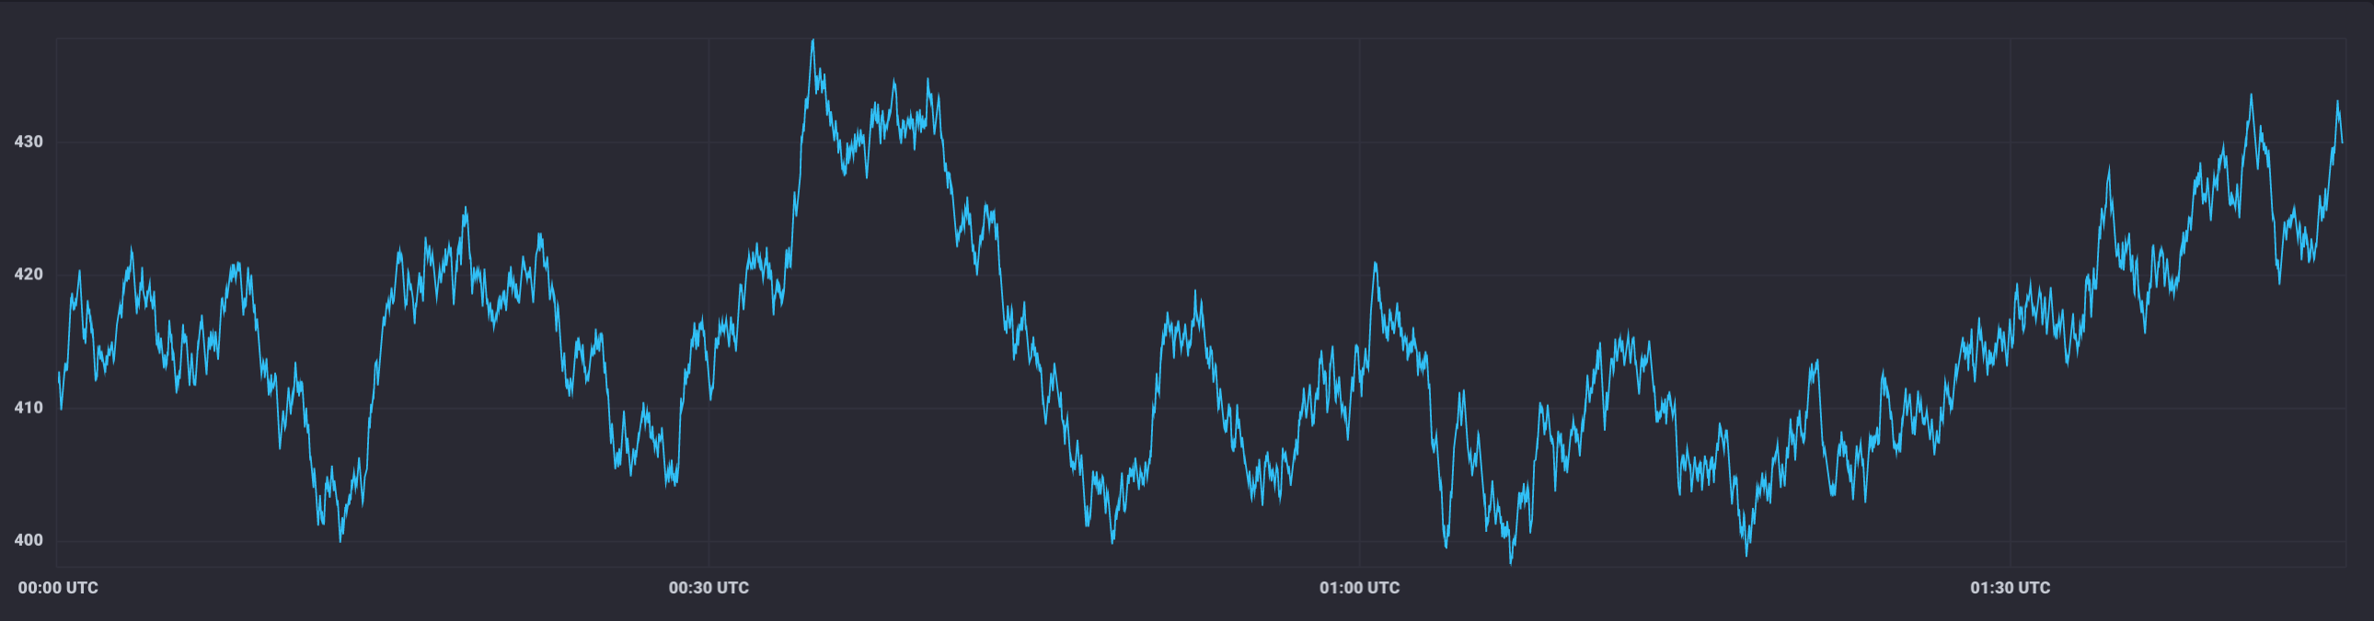
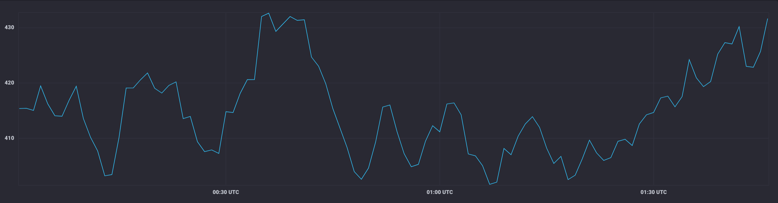
Typical use case: downsampling data
aggregateWindow(every: 1m, fn: mean)

Slide 46
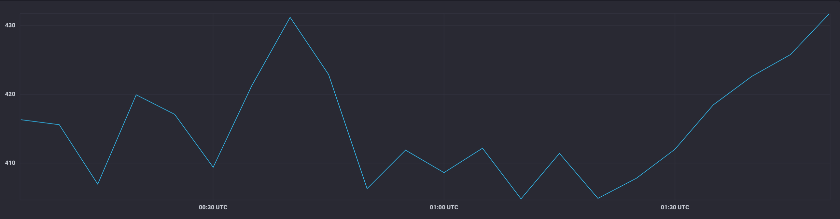
Typical use case: downsampling data (cont.)
aggregateWindow(every: 5m, fn: mean)

Slide 47
Let’s get dirty!
7

Slide 48
Continuous Linear Pizza Oven
Learning goals:
aggregateWindow
s2
s1

Slide 49
Task
Extract the moving average of the temperatures observed in the cooking base area over a window of 2 minutes
Extract the moving average of the temperatures observed by S2 over a window of 3 minutes

Slide 50
Take home message
The aggregateWindow() function eases the downsampling task
The createEmpty flag changes the behaviour of the aggregateWindow() function.
If createEmpty = false the aggregateWindow() function does not consider the empty windows in the aggregation
If createEmpty = true (default) the aggregateWindow() function considers all the windows

